Slide 1
Category review: Chips
June 2020
Retail Analytics
Brand note: If client logo is not required, use alternate title page layout right click slide thumbnail > Layout > Title

Slide 2
Notes:
To view Privacy video explaining how important data privacy is to Quantium, please click here: https://www.youtube.com/watch?v=Zq1QDAkoRzU
or here Q:\Company Reference\Brand & Design\Brand videos\Q Privacy.mp4
At Quantium, we believe that data is the behavioural footprint of humanity and that it has to be treated with the utmost care and responsibility.
Histories, attitudes, indeed lives are stored within it in ways that aren’t always apparent – and that’s what makes its potential so powerful.
To work with it responsibly, sensitively, we set ourselves the highest data privacy protection and governance standards.
We have spent 17 years perfecting privacy-by-design and secure-by-design principles. Central to this is not holding any personally identifiable information about people –
we neither receive it, and put the necessary protections in place to be unable to decipher it.
Every aspect of handling data is safeguarded: from its de-identification, to its encryption – data security is paramount and of the highest grade.
We pride ourselves on gaining the trust of iconic organisations around the world through years of securely working with their data,
and in turn the trust that builds with their stakeholders.

Slide 3
Executive summary
01
Task 1
Highest number of purchases came from Older families (from the Budget category), Young singles/ couples (from the Mainstream category) and Retirees (from the Mainstream category).
Mainstream Young singles/couples spent the highest average price for chips (~ $4.06), with Mainstream Midage singles/couples the second highest spender per average price (~$3.99)
Trial stores 77 and 86 had a significant increase in sales in total sales across the trial period when compared to their control stores 233 and 155 respectively
Trial store 88 also had an increase in total sales, however this increase was not statistically significant
02
Task 2

Slide 4
01
Category

Slide 5
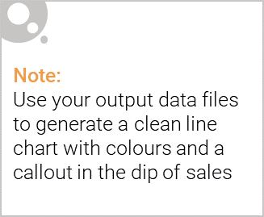
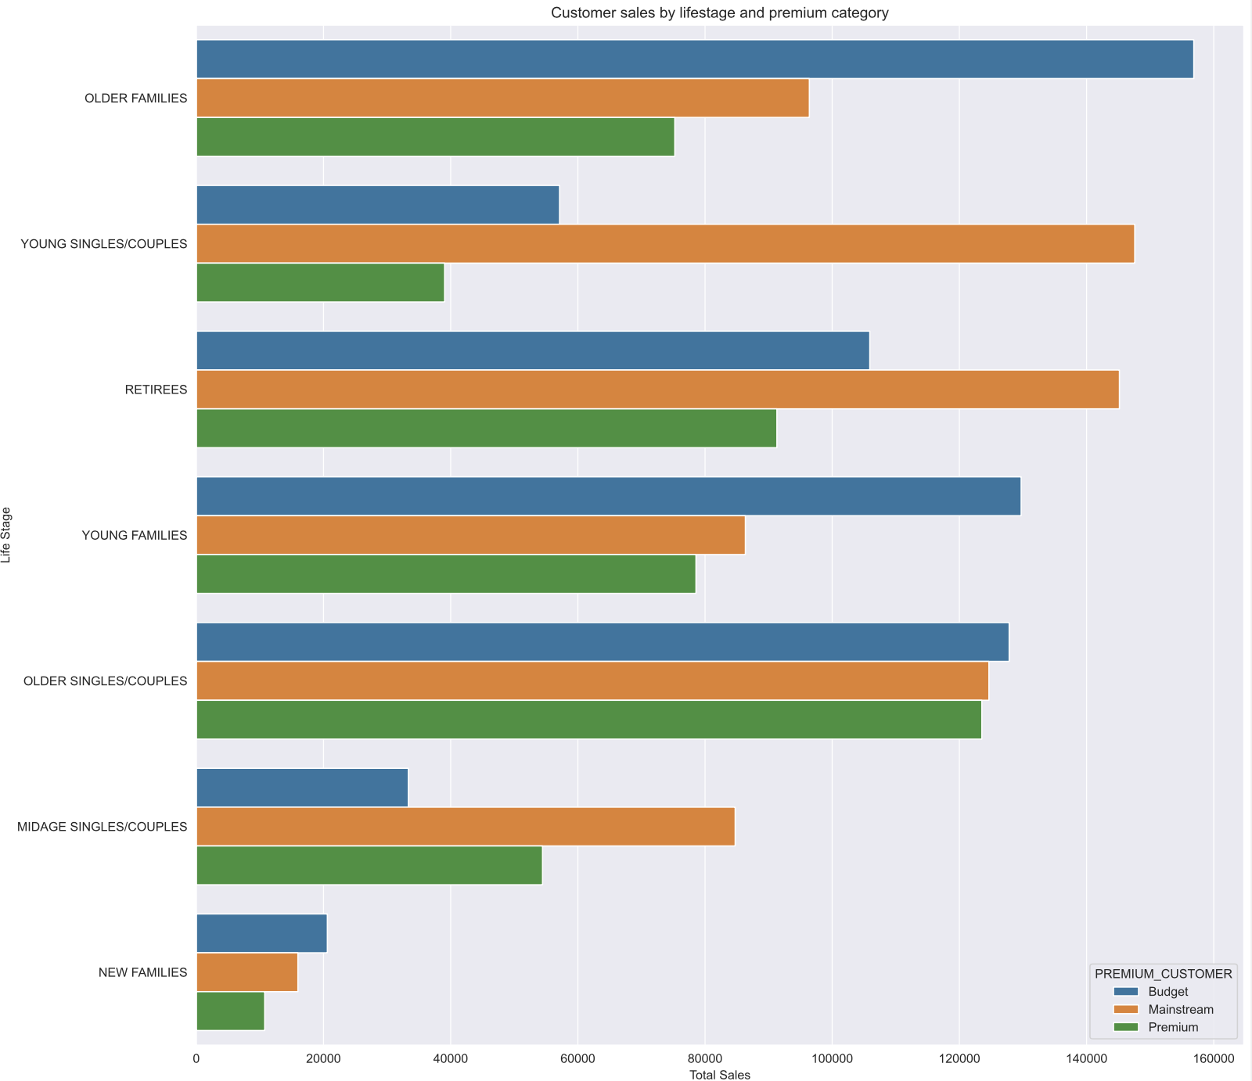
Highest sales come from Older families (budget) and Young singles/couples (mainstream)

Slide 6
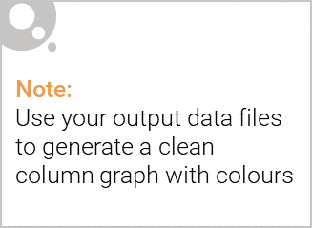
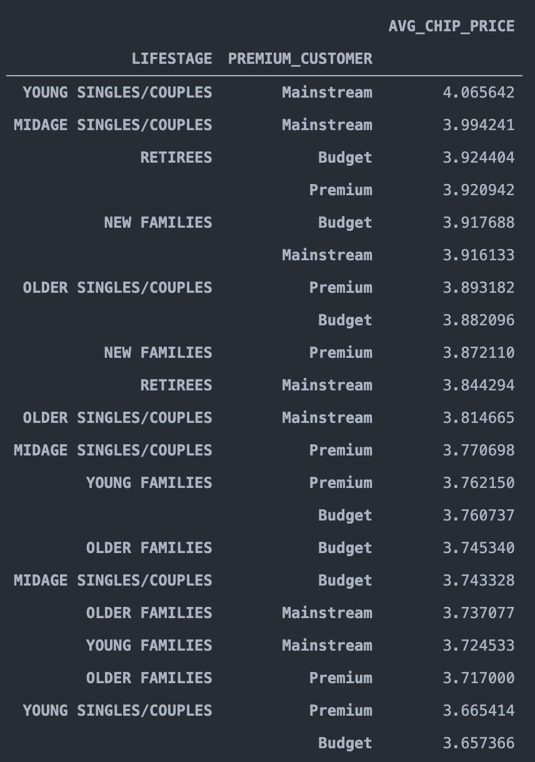
Highest spend per packet of chips came from Mainstream Young singles/couples

Slide 7
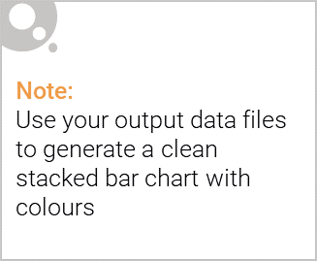
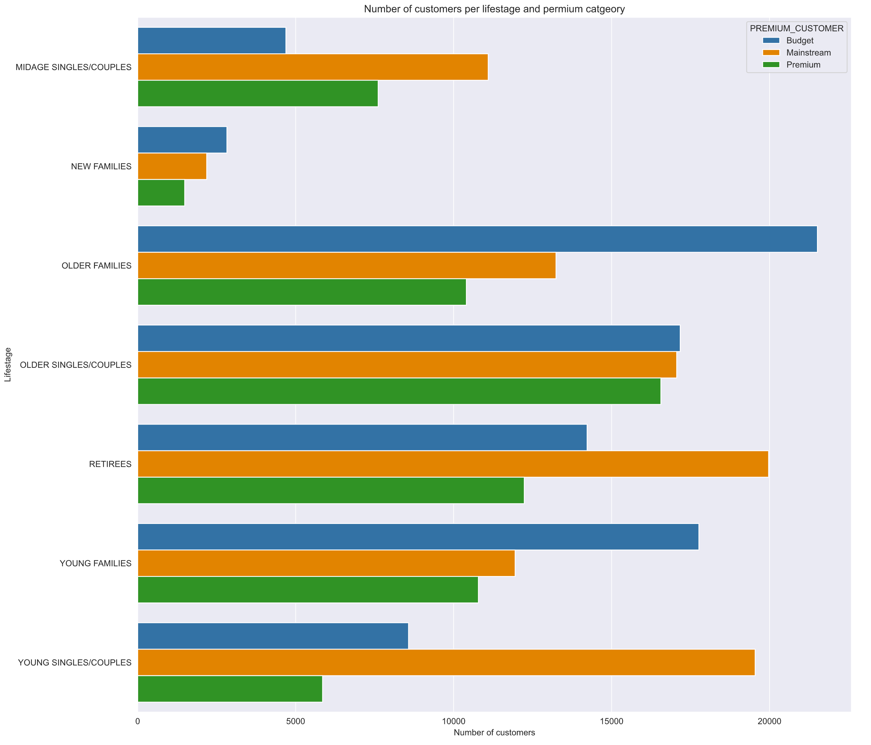
Editable (delete this)
Largest proportion of customers come from the Older families (mainstream), Retirees (mainstream) and Young singles/couples (mainstream) categories.

Slide 8
02
Trial store performance

Slide 9
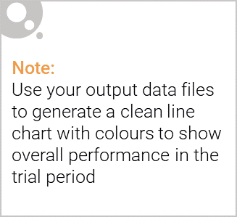
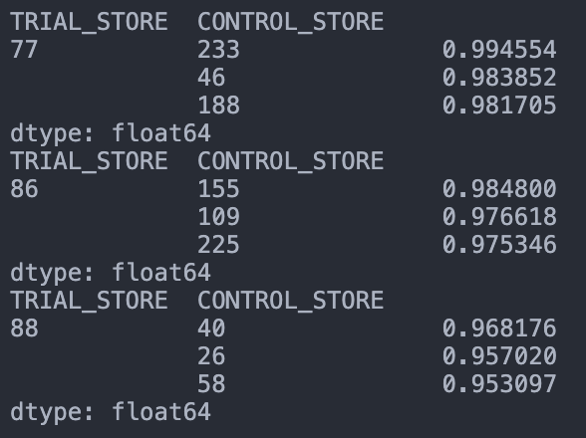
Trial store/ Control store pairs based off a metric taking the correlation and magnitude into equal consideration

Slide 10
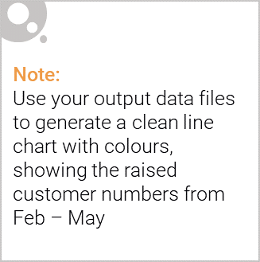
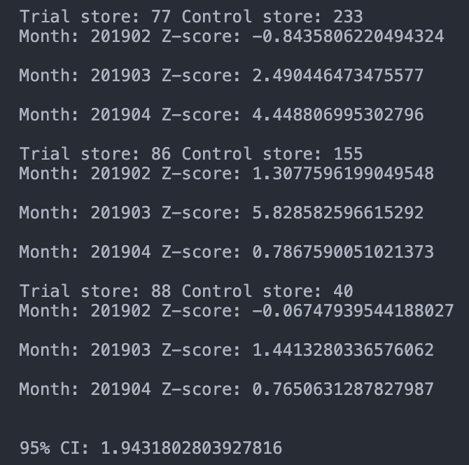
Trial store 77 had significant increase in sales in March and April.
Trial store 86 had significant increase in sales in March
Trial store 88 had an increase, however it was not significant

